Slide 1
Game Theoretic Neural Network Pruning
Daniel Campos
Dec 3rd, 2020
CS598RM

Slide 2
Outline
Overview ML + DL
Trends in DL model size
Compression Methods
Network Pruning
Pruning as agame
Experiment Structure
Results
Discussion
Future Work

Slide 3
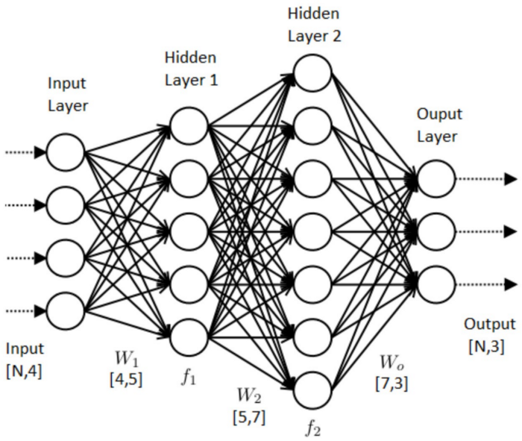
DL Overview
Neural Network is a collection of artificial neurons loosely modeled after biological neurons.
Each neuron takes some input, does some type of computation, and passes result to next layer.
Each neuron has a collections of weights and biases for each of its connections to other neurons. These weights and biases are optimized over time essentially allowing the model to ‘learn’
Called Deep Learning because we have networks that have many layers(aka deep).
Chain together linear transformation(multiply weights, add bias) followed by non linear function(tanh, relu, etc).
Train model using backpropagation.
Select some portion of dataset, calculate a loss, update each parameter by learning_rate*how much they caused loss.

Slide 4
DL Overview Continued.
Expected output
loss
Forward pass of the data takes some input and transforms it to produce an predicted output, y_hat.
Loss = y-y_hat
Backward pass provides the impact of each weight/bias in
Predicted output
Non-linearity
Linear transform
forward pass
backward pass
Non-linearity
Linear transform
Input

Slide 5
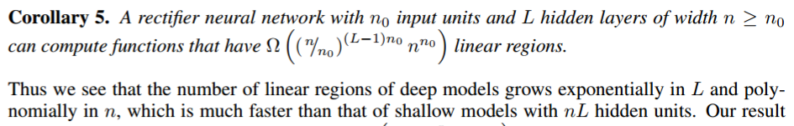
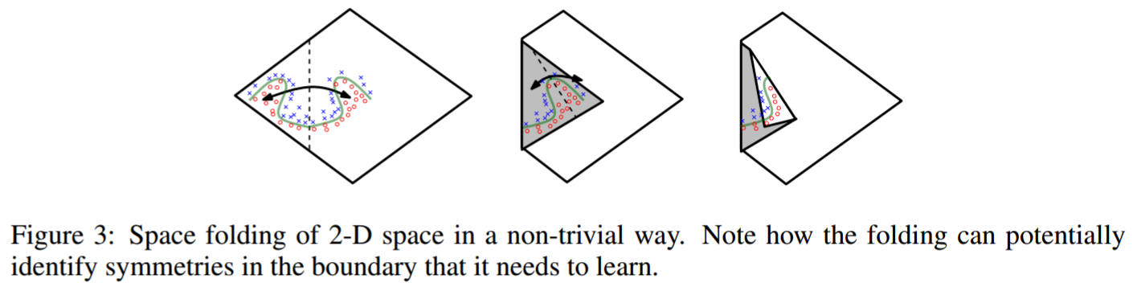
Why adding depth helps
Deeper networks can split the input space in many (non-independent) linear regions than shallow networks
Montúfar, Pascanu, Cho and Bengio. On the number of linear regions of deep neural networks NIPS 2014

Slide 6
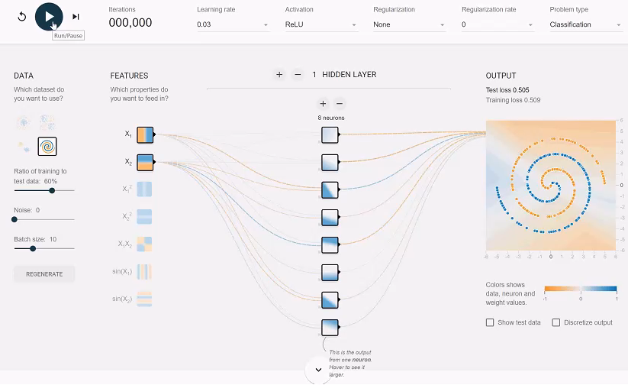
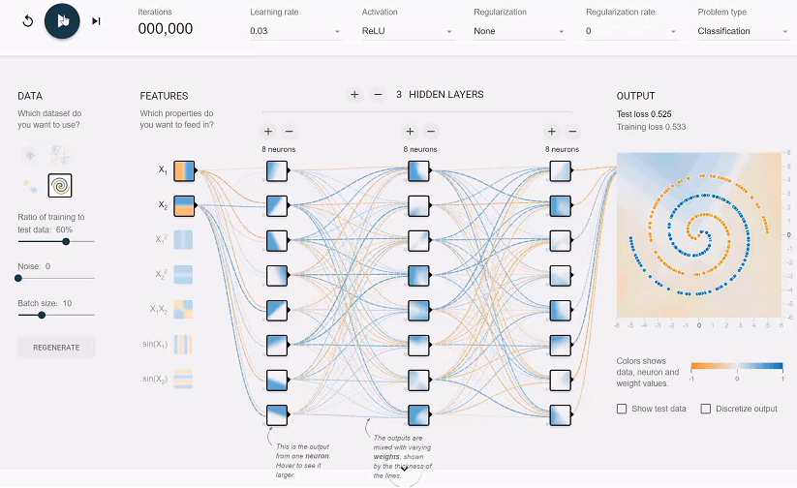
Why adding depth helps
http://playground.tensorflow.org

Slide 7
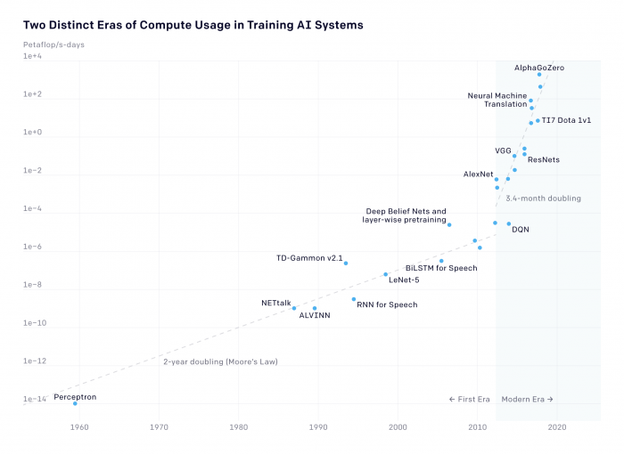
DL Model Size
Compute usage to train AI models has increased 300,000 fold in the last seven years.

Slide 8
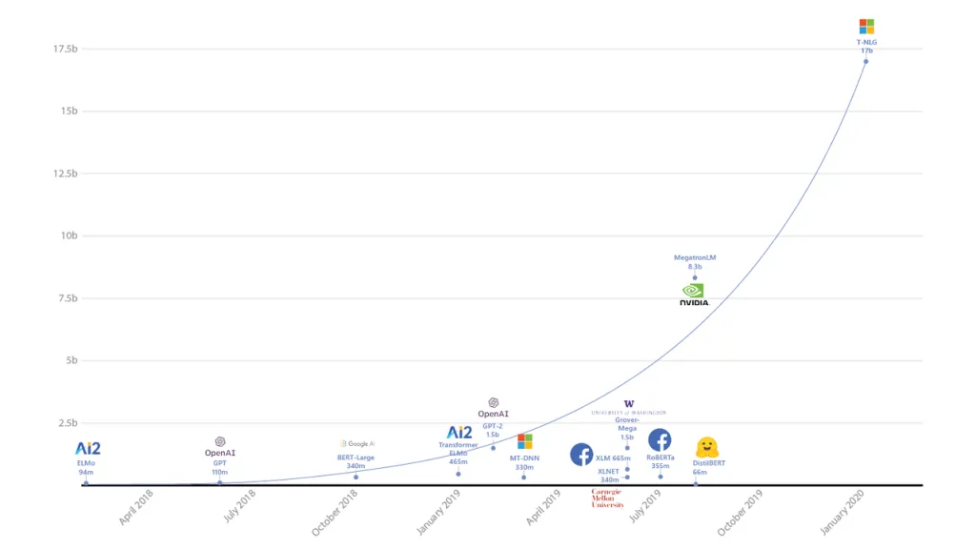
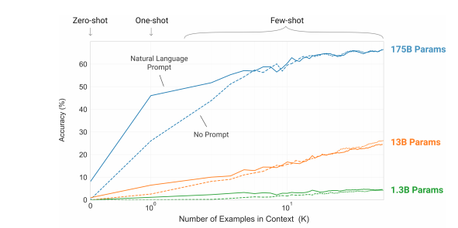
Parameter Sizes
DL Model Size(Cont.)
Left Image Right Image

Slide 9
Efficiency Gaining Methods
Efficient design of original network link
Design novel network architectures that exploit computation / memory efficient operations(e.g. MobileNet, EfficientNet)
Model Distillation link
Train a big model into a smaller model using a teacher student method
Student model is smaller can can be used in many places
Quantization link
Convert weights an inputs into smaller representations(e.g. Float16, float 8, etc).
Huffman Encoding link
Represent more common weights with smaller bit representations
Pruning
Remove links that aren’t important.

Slide 10
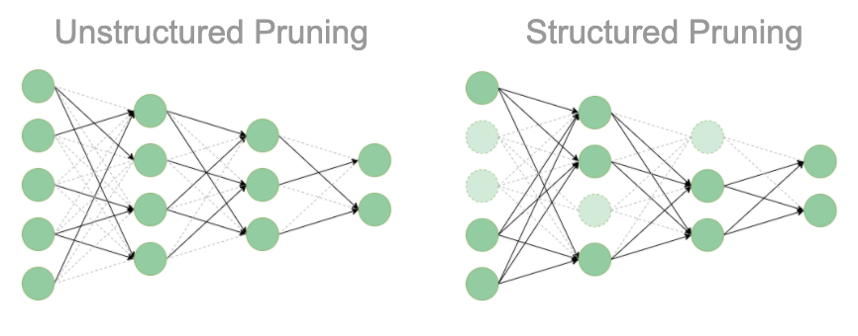
Network Pruning
Introduced by LeCun in 1990 paper Optimal Brain Damage
Remove structure of network
Structured removes entire neurons
Makes the network smaller in pure mb terms.
Unstructured sets individual weights in a neuron to 0.
Especially interesting because introduces multiplication by zero to network which means some connections get turned into no-ops
Runs faster than structured or non sparse network and can run better on CPU than GPU.
Pruning effectively acts as an architecture search within a network.
At lower levels of sparsity(<50%) a model will usually generalize better. Pruning really acts like a regularizer here.
Higher sparsity models lose accuracy for big speedups
Well-pruned ResNet-50 can almost match baseline accuracy with 90% sparsity.

Slide 11
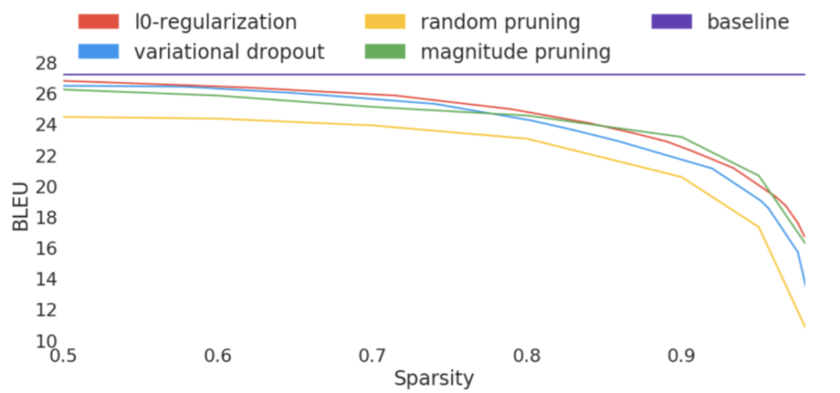
Network Pruning (cont.)

Slide 12
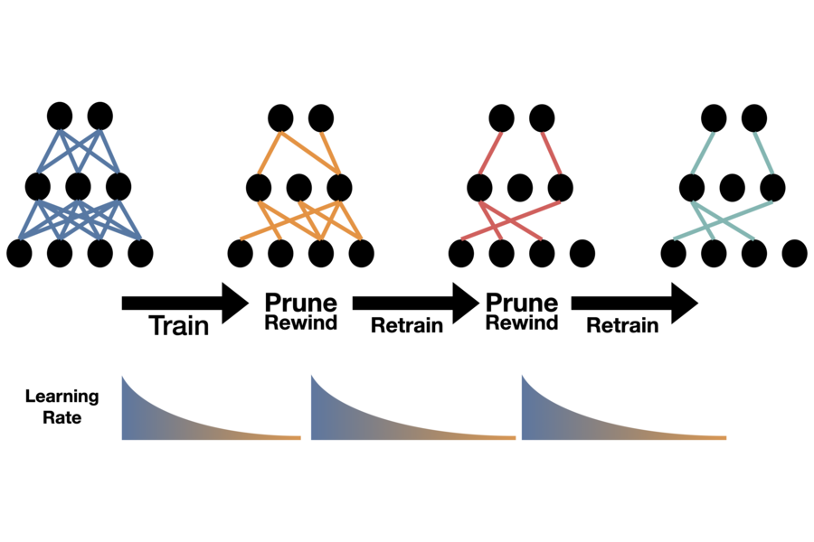
Network Pruning

Slide 13
Train Large, Then Compress
Smaller models execute quicker but wider and deeper models converge in fewer steps.
Deep Networks do better with pruning than wider ones.
Optimal training strategy is train super big LMs but stop quickly.

Slide 14
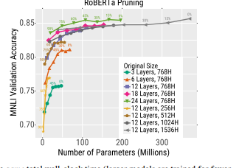
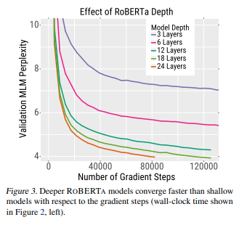
Train Large, Then Compress

Slide 15
Types of Pruning
L1 Norm: zeroing out the ones with the lowest L1-norm
Random: Regularization on the system. Removes dependence on individual neurons
Magnitude: Remove weights closest to Zero
Movement: Remove weights that change the least(focused on transfer learning)
Positive: Like magnitude but only for positive weights
Negative: Like magnitude but only for only negative weights

Slide 16
Issues with Single Strategy Pruning
If you prune with only one mechanism you can over optimize the network to what that optimal is.
L1 pruning and Magnitude preserve weights with high magnitudes even if there is duplication. Weights with smaller values could that complement larger weights aren’t kept.
Random regularizes but doesn’t help find optimal architecture.
No way to combine two goals with network pruning like FLOP aware pruning or adversarial robustness.

Slide 17
ENTER Game Theory!

Slide 18
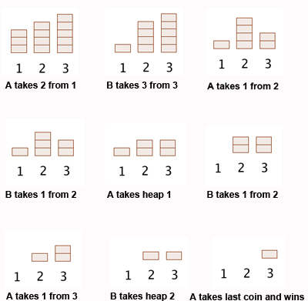
Nim Game
Combinatorial game where N players take turns taking objects from several heaps. Only rule is player must take at least a single object in their turn.
Most well-known example of an impartial game when played by 2 players as each player has the same amount of moves.
Completely solved for 2 player as the exact strategy has been found for any starting combination.

Slide 19
Pruning as a N player Game
Reformulate Pruning as a N player game of Nim.
At each round of pruning players alternate in removing weights from the network.
Modifications to NIM
players randomly alternate who goes first
Since we prune layer by layer and cap the target sparsity at a given epoch not all players are able to play equal turns.
At each turn in the game each agent prunes with its best response dynamics.
Possible that none of the players has a winning strategy
Goal of the agent is to prune an existing network given their strategy profile.
Strategy profile defined by what kind of agent they are
Mathematical Games Three-player impartial games

Slide 20
Experiment
Train various models and datasets and explore how framing pruning as N-player game effects results
Models
ResNet50
VGG16
DPN92
Dataset
Cifar10
Cifar100
Prune using
Random
L1
Magnitude
Combination of the above

Slide 21
Experiment
All 6 models trained identically
500 epochs. Take model with highest validation accuracy
Stabilize model for 2 epochs
Prune gradually with retraining between pruning
5% target prune per epoch
Prune uniformly in each layer
Small layers may not be able to do 5% each time. If we over prune one epoch we don’t prune until we are beneath target threshold
Target sparsity 95%
Evaluate every epoch
Fine tune prune networks 10 epochs

Slide 22
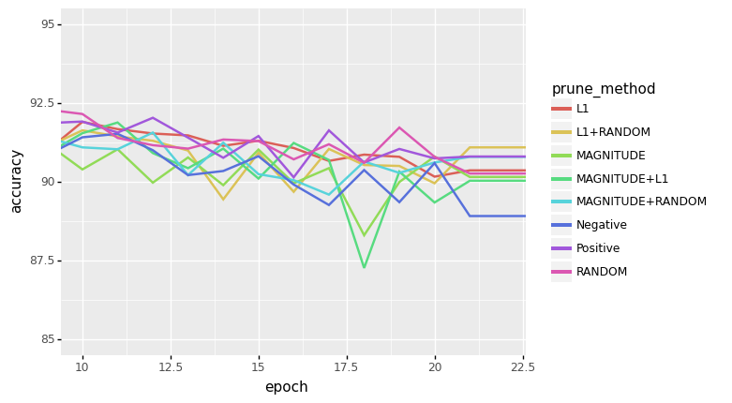
VGG16 Cifar 10

Slide 23
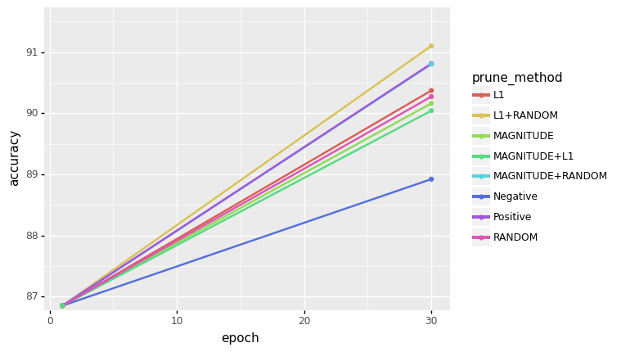
VGG16 Cifar 10

Slide 24
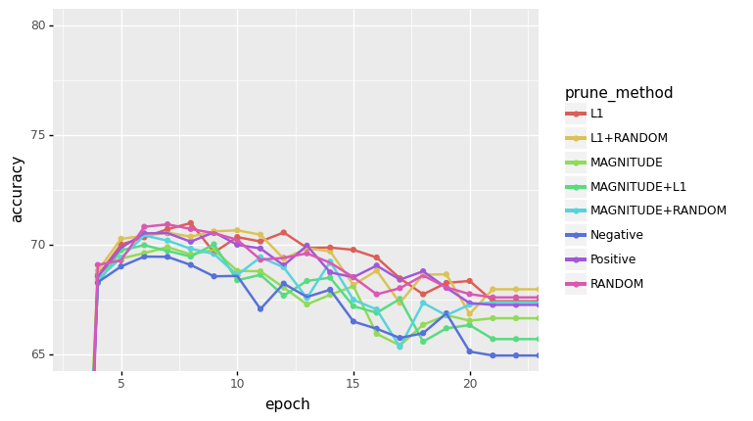
VGG 16 Cifar100

Slide 25
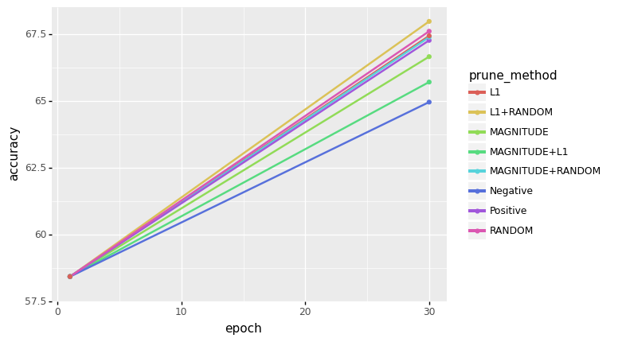
VGG 16 Cifar100

Slide 26
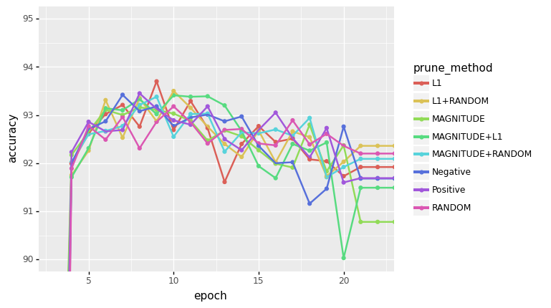
ResNet50 Cifar10

Slide 27
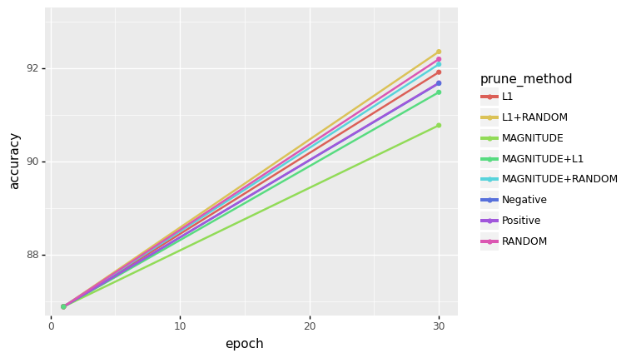
ResNet50 Cifar10

Slide 28
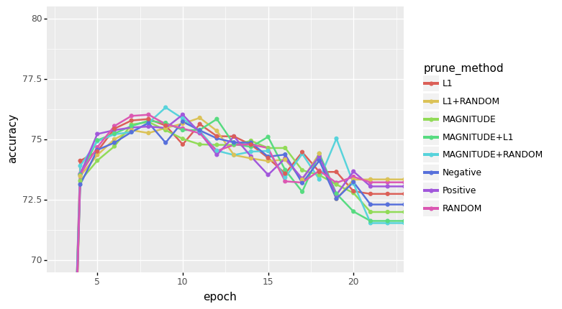
ResNet50 Cifar100

Slide 29
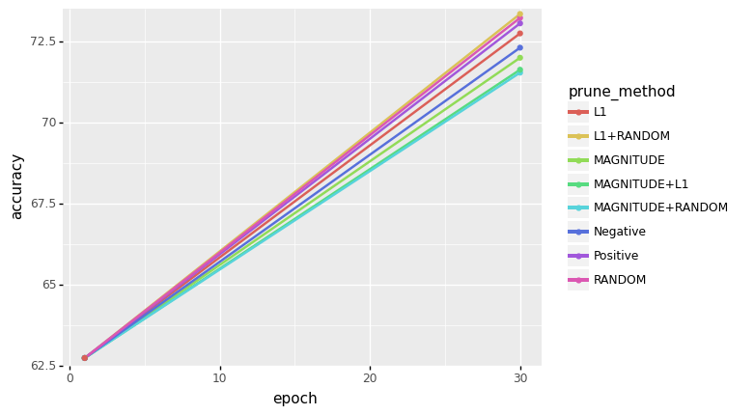
ResNet50 Cifar100

Slide 30
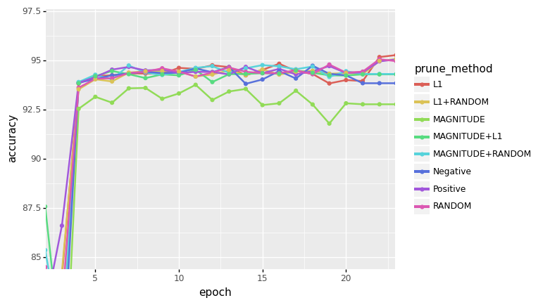
DPN92 Cifar10

Slide 31
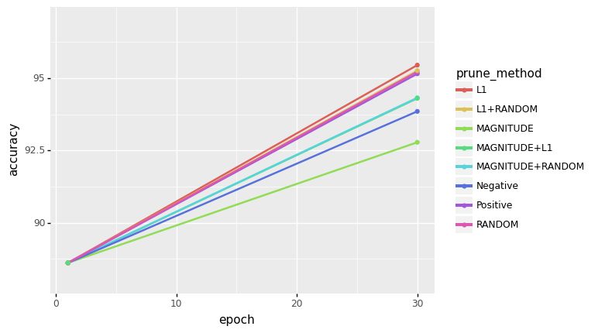
DPN92 Cifar10

Slide 32
DPN92 Cifar10

Slide 33
DPN92 Cifar100

Slide 34
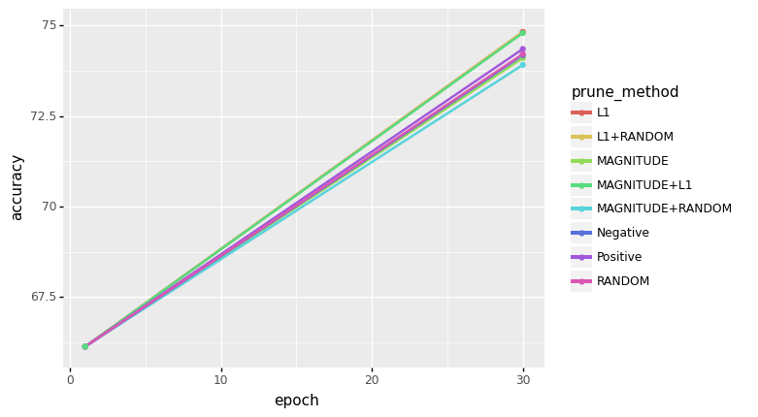
DPN92 Cifar100

Slide 35
Discussion
In virtually every experiment mixed strategy of L1+Random outperforms every other strategy
Most experiments addition of Random Strategy outperforms pure strategy
Pure Random Pruning does surprisingly great at all sparsity levels and models

Slide 36
Future Work
Explore on bigger models/more difficult datasets
Explore pruning strategies that are more downstream targeted
Adversarial Robustness
FLOP optimized
L1 at overall network level
Explore NIM game as comparison of layer vs network pruning
Suggestions?

